Slide 1
TEACH ME HOW TO DOUG<E>
Quinn Giebel, Lincoln Schroeder, and Adam Salt

Slide 2
MAGIC THE GATHERING CARD CATALOG
Searchable
Display Cards
Usable Offline

Slide 3
WHY WE CHOSE
It can be difficult to keep track of cards for Magic the Gathering.
When we looked at different Catalogs they were all web based.
It was something that we were interested in.

Slide 4
What we completed
What we didn’t finish
Search
Add cards to collections
Remove cards
GUI
Default collection
Runnable on Windows
Display Cards in desired format
Create multiple collections
Add or Delete collections
Couldn’t quite get file writing completed in the .jar

Slide 5
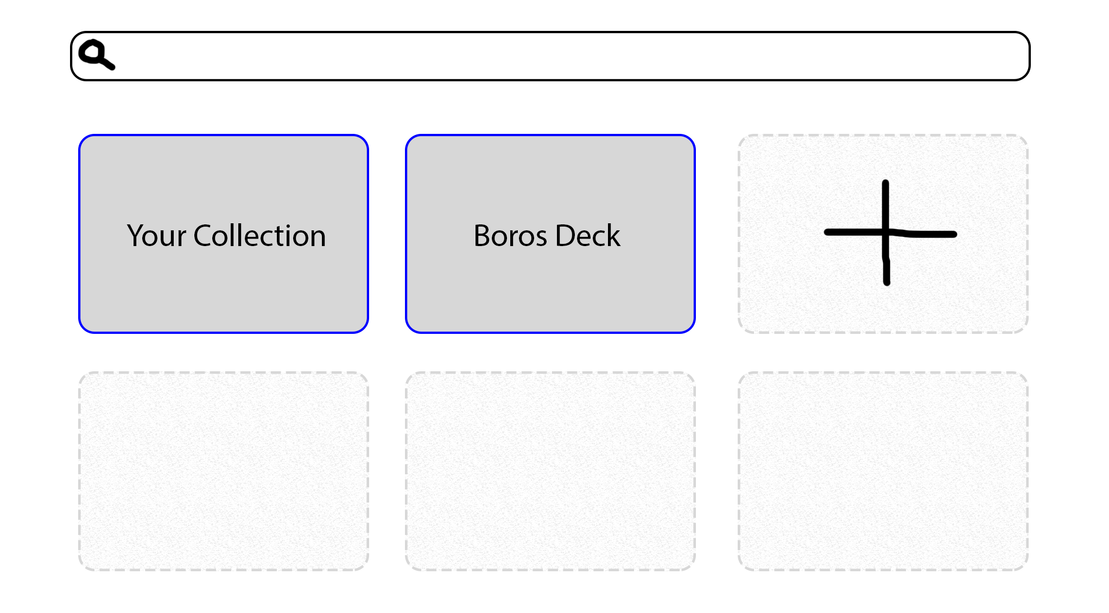
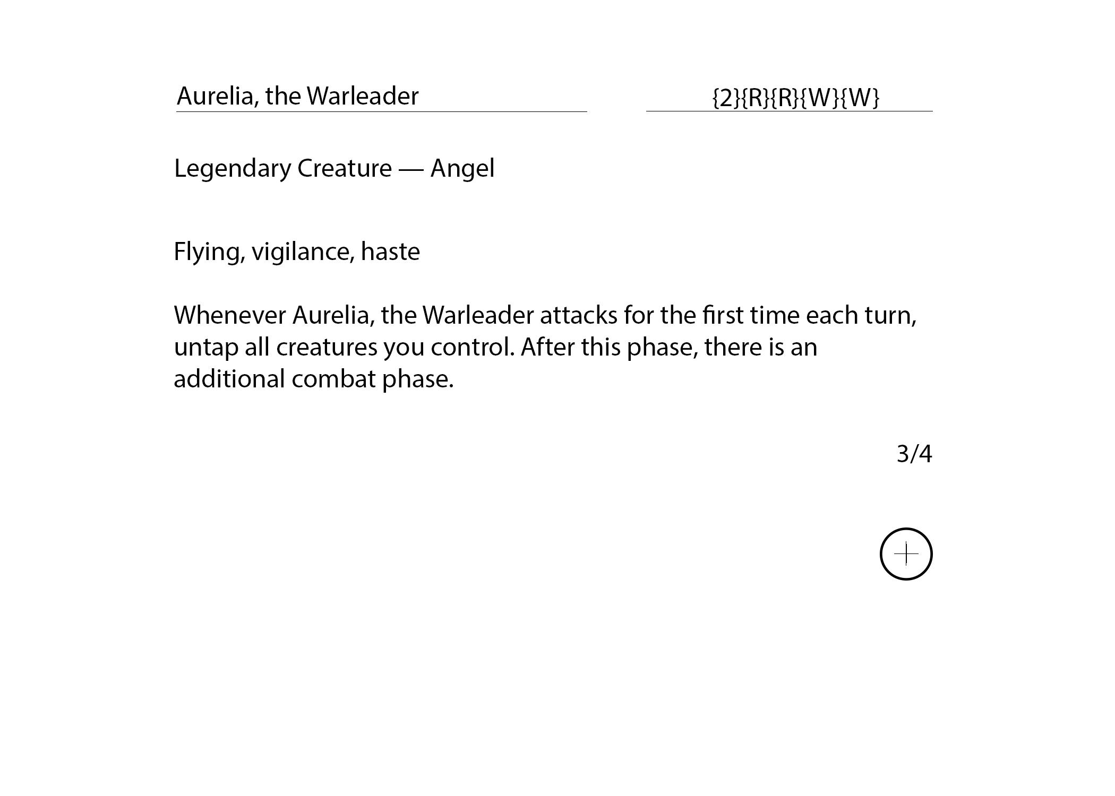

Slide 7
WHAT WE LEARNED
IntelliJ is much better than NetBeans.
Planning features can be difficult when you don’t know what is necessary.
Organization is very important.
Waterfall Method was not the best option for this project.
Sleep is overrated

